Slide 1
Industrial Anomaly Detection
Daniel-Cristian-Marian Țăpuși
Marian-Claudiu Neagu
Constantin-Mihai Ciocan

Slide 2
Introduction
The Task: Automating visual inspection to identify subtle deviations misrouted across high-variance assembly parts
The Imbalance: "Normal" data is abundant, but defects are statistically rare, with some critical parts showing anomalies in less than 5% of cases
The Federated Goal: Building a "Global Knowledge Base" that learns from multiple production lines without ever moving sensitive raw data from its source

Slide 3
Dataset
Extended AutoVI with real assembly-line parts (engine wiring, underbody pipes, clips, screws etc)
Size: 3k train images, 3k test images
Highly imbalanced defect rates across parts
Preprocessing: Resize to 256x256; normalization applied
Augmentation: Random Horizontal Flips (p=0.5) applied during training

Slide 4
Model Architecture: PatchCore
Feature extraction using pre-trained CNNs (ResNet-50) – multi-scale features
Memory bank of "normal" patch representations from training data
Detecting anomalies by comparing test patches to the memory bank

Slide 5
Trust-enhancing mechanisms - fairness
Adaptive Per-Category Sampling
Rare categories get more patches per image
Preventing bias toward common categories
Diversity-Based Coreset Selection
greedy algorithm that identifies the most informative patches to represent the full range of "normal" behavior while reducing the memory bank size
Lipschitz constraint - preventing the model from over-representing common, repetitive patterns, ensuring it learns to recognize unique structural details

Slide 6
Trust-enhancing mechanisms - robustness
Multi-Scale Features
Looking at both fine details and overall structure
Feature Normalization
Handling different lighting/brightness automatically
Working across different cameras and conditions
Privacy-Preserving Noise
Integrating Differential Privacy (DP) by injecting calibrated Gaussian noise into the memory bank, mathematically guaranteeing that raw features cannot be leaked

Slide 7
Centralised Experiment - Training
patches_per_category=30000
feature_projection_dimension=128
batch_size=16
L=0.3
lam=0.5
Extracted features from layers 2 and 3
Results:
Image AUROC: 0.7214
Image AP: 0.5269
Pixel AUROC: 0.8616

Slide 8
Federated Experiment - Distributed Client Scenarios
Five non-IID clients mirroring factory lines:
C0: High-defect wiring/pipes
C1: Clips/staples/pump connectors
C2: Tank screws/radiators/brake discs
C3: Underbody screws/brake discs
C4: Mixed (all categories)

Slide 9
Federated Experiment - Standalone training per client
Separate model for every client
Same parameters as centralized
Aggregated all the clients
Results:
Image AUROC: 0.7155
Image AP: 0.5138
Pixel AUROC: 0.8454

Slide 10
Federated Experiments
Local Training: each client runs the PatchCore pipeline on its local assembly parts
Clients send their optimized Memory Banks and Category Statistics to the Server; the Server returns the aggregated Global Model

Slide 11
Federated Experiments
For all federated experiments:
5 clients with distributed data (different factories/sites)
3 training rounds
Each client: 10,000 patches per category
Global target: 150,000 patches total

Slide 12
Federated Experiment (FedAvg)
Concatenate all client memory banks together
Randomly subsample to target size (150,000 patches)
No weighting - treats all clients equally

Slide 13
Federated Experiment (FedProx)
Weight clients based on similarity to previous global model
Clients closer to global model get higher weight
Encourages consistency across rounds
Client-Side FedProx (mu=0.01)
Each client also adjusts toward global model during local training
Computes distance to global, uses as regularization signal
Prevents clients from drifting too far from consensus

Slide 14
Federated Experiments (Category Aware)
Ensures each product category gets equal representation
Aggregates by category first, then samples within each category

Slide 15
Federated Experiments - Results
 | Centralised | FedAvg | FedProx | Category Aware
Image AUROC | 0,7214 | 0,7420 | 0,7461 | 0,7523
Image AP | 0,5269 | 0,5661 | 0,5810 | 0,5821
Pixel AUROC | 0,8614 | 0,8678 | 0,8697 | 0,8732

Slide 16
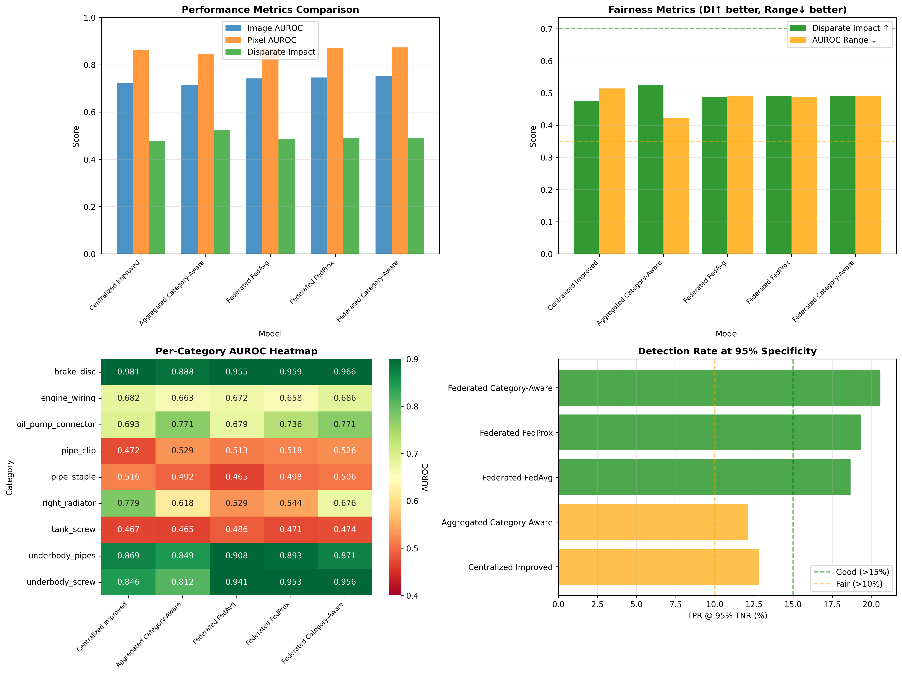

Slide 20
Interpretability
Distance-Based Scoring
Anomaly score: euclidean distance to nearest normal patch
Spatial Anomaly Localization
Pixel-level heat maps
Visual validation

Slide 21
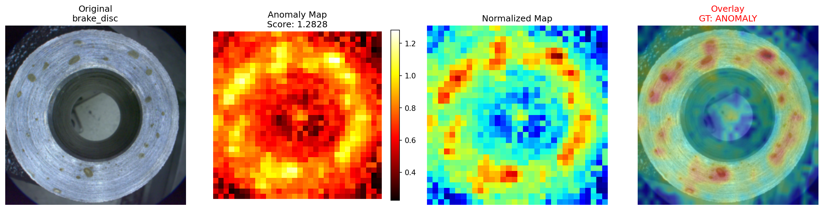
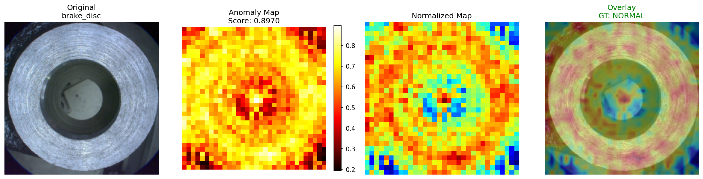
Interpretability – Centralised

Slide 22
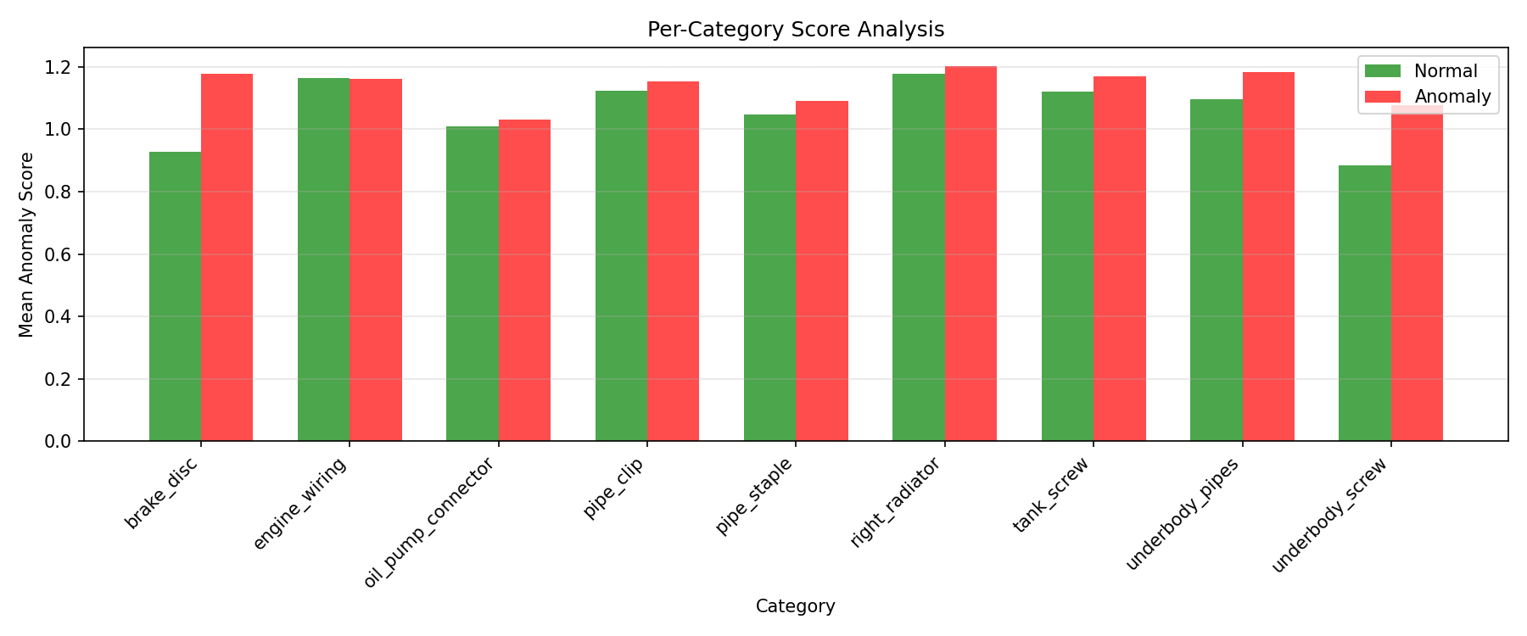
Interpretability – Centralised

Slide 23
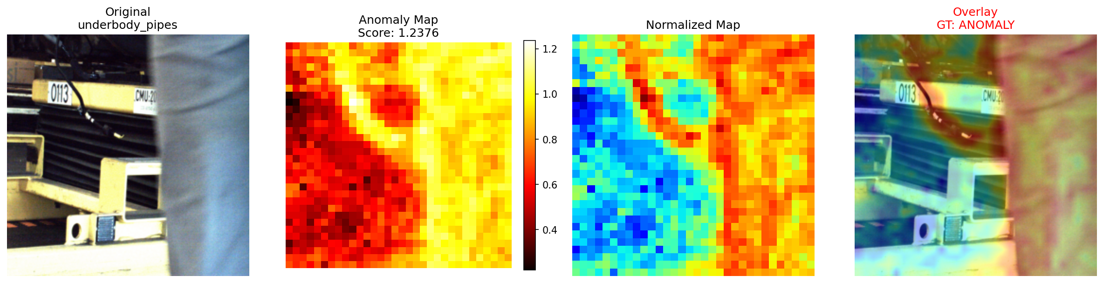
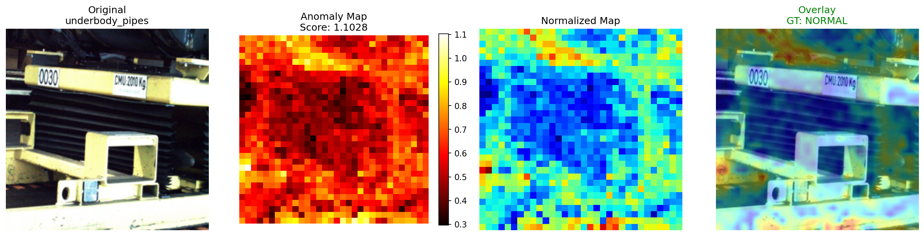
Interpretability – FedAvg

Slide 24
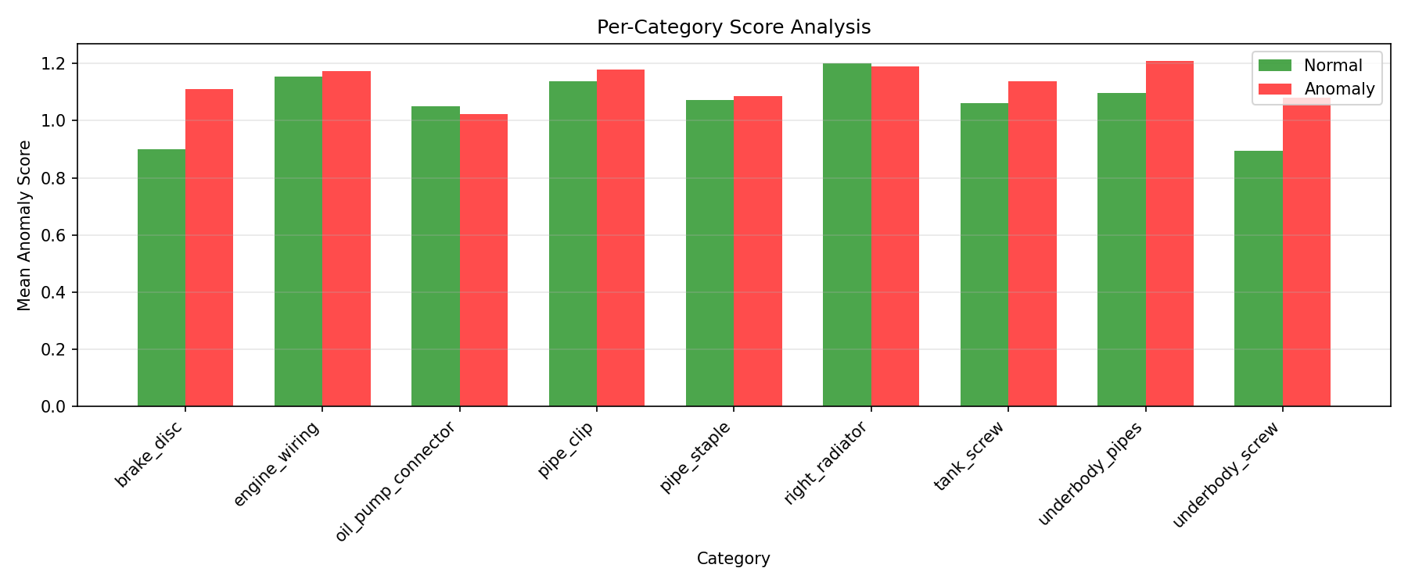
Interpretability – FedAvg

Slide 25
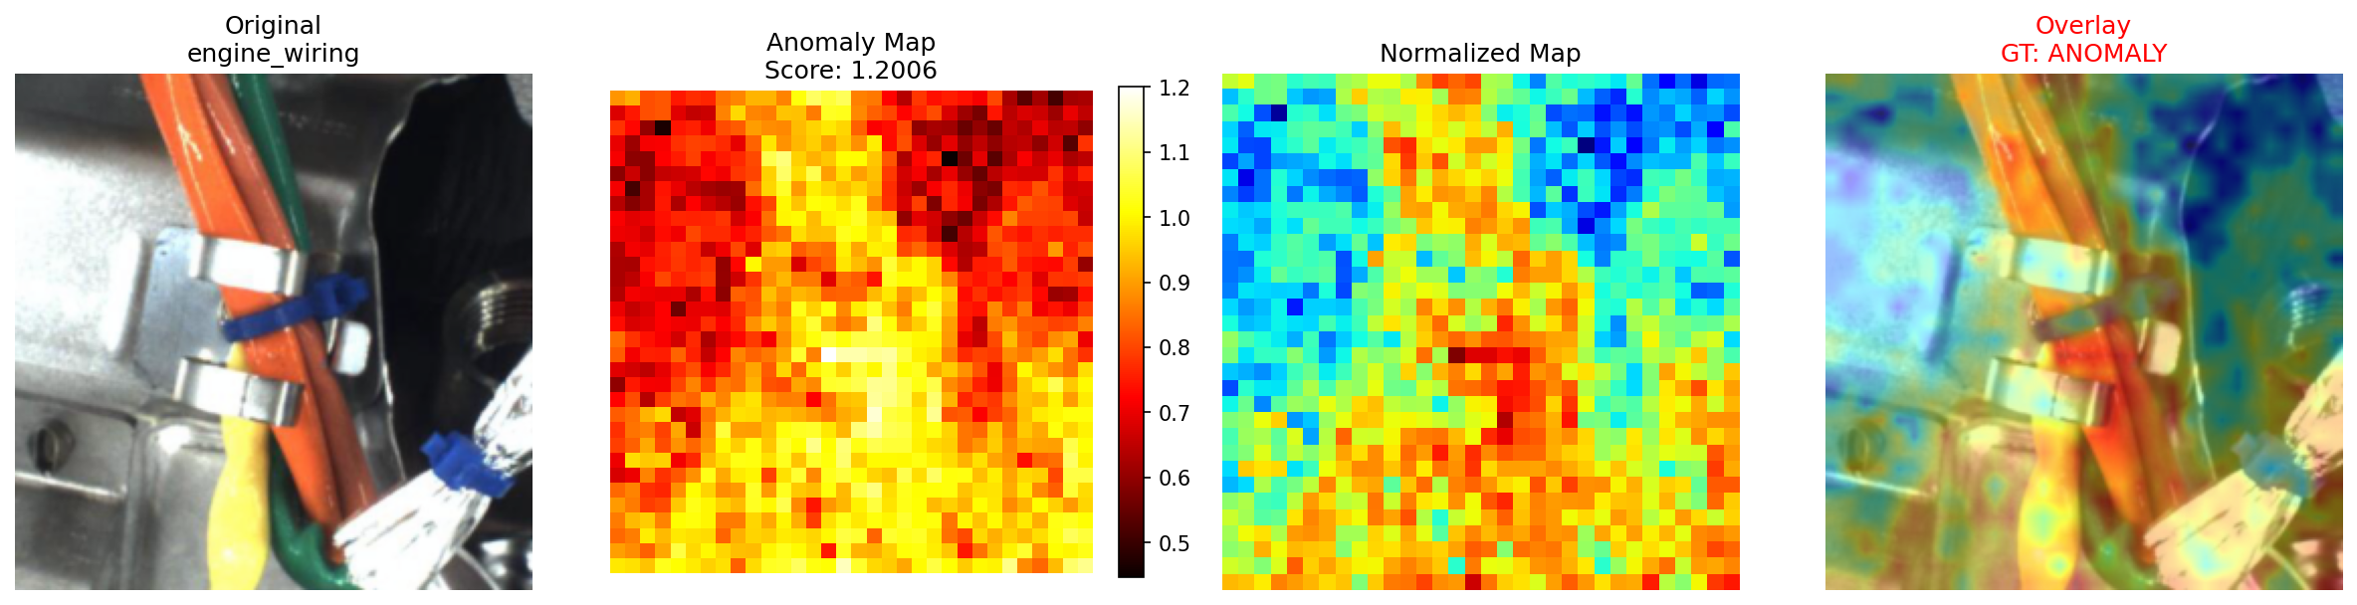
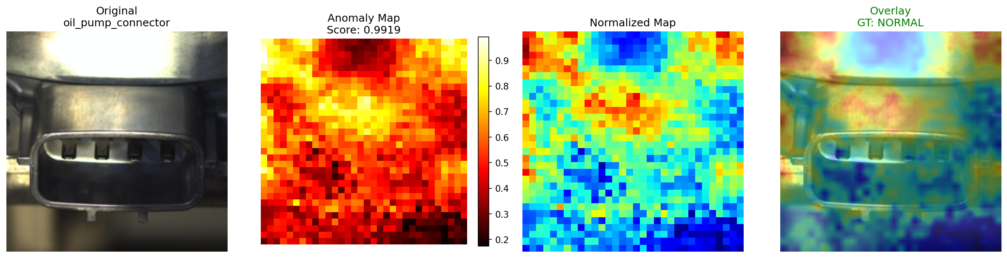
Interpretability – FedProx

Slide 26
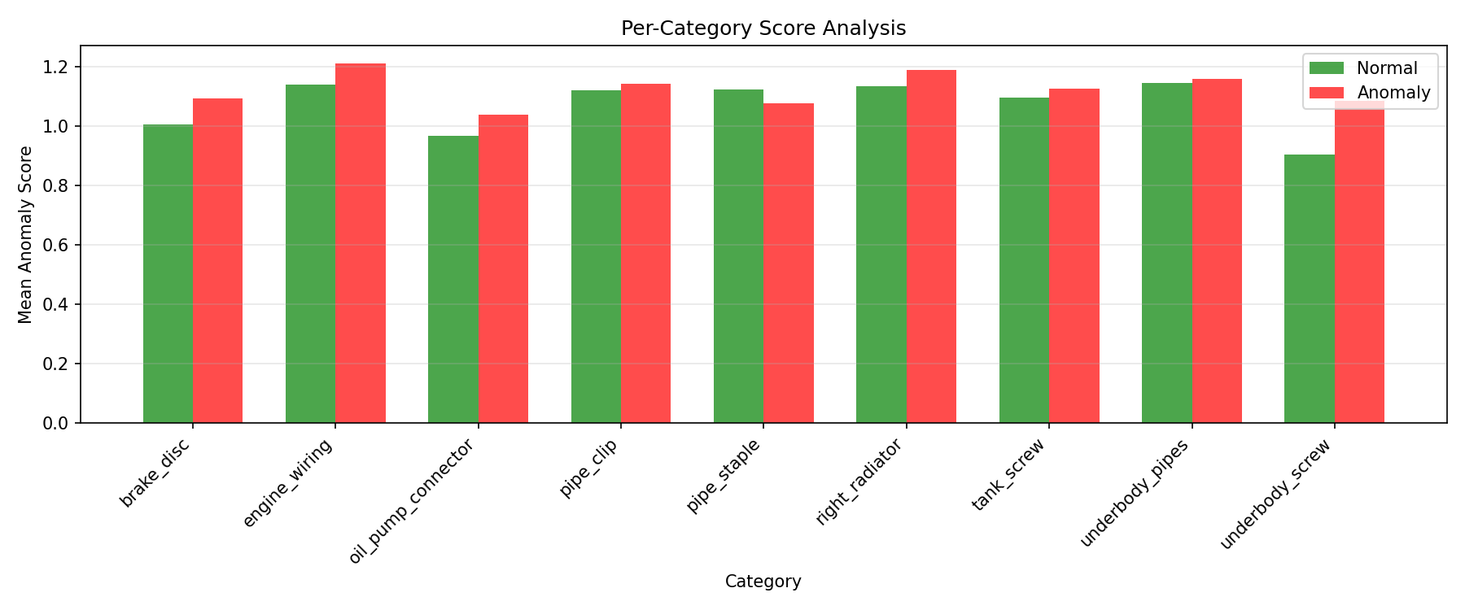
Interpretability – FedProx

Slide 27
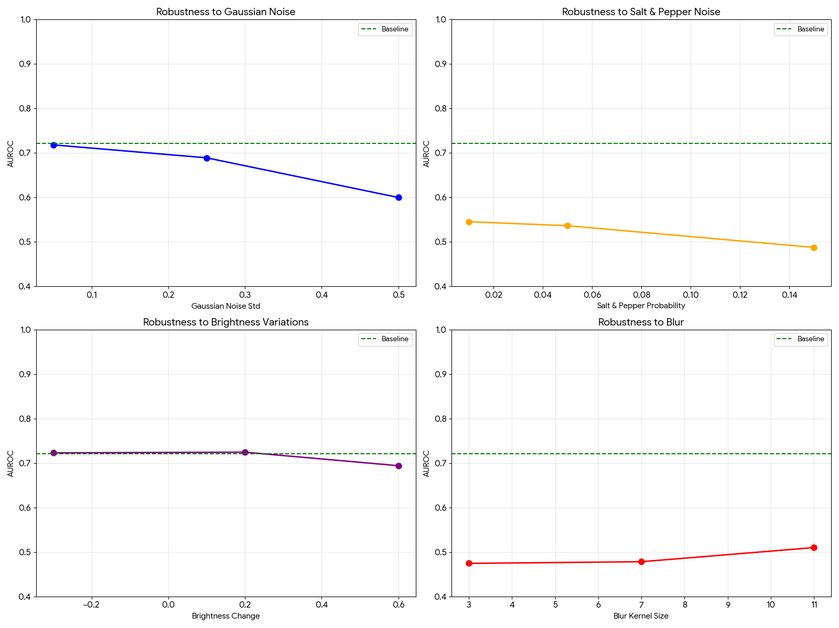
Robustness - Centralised

Slide 28
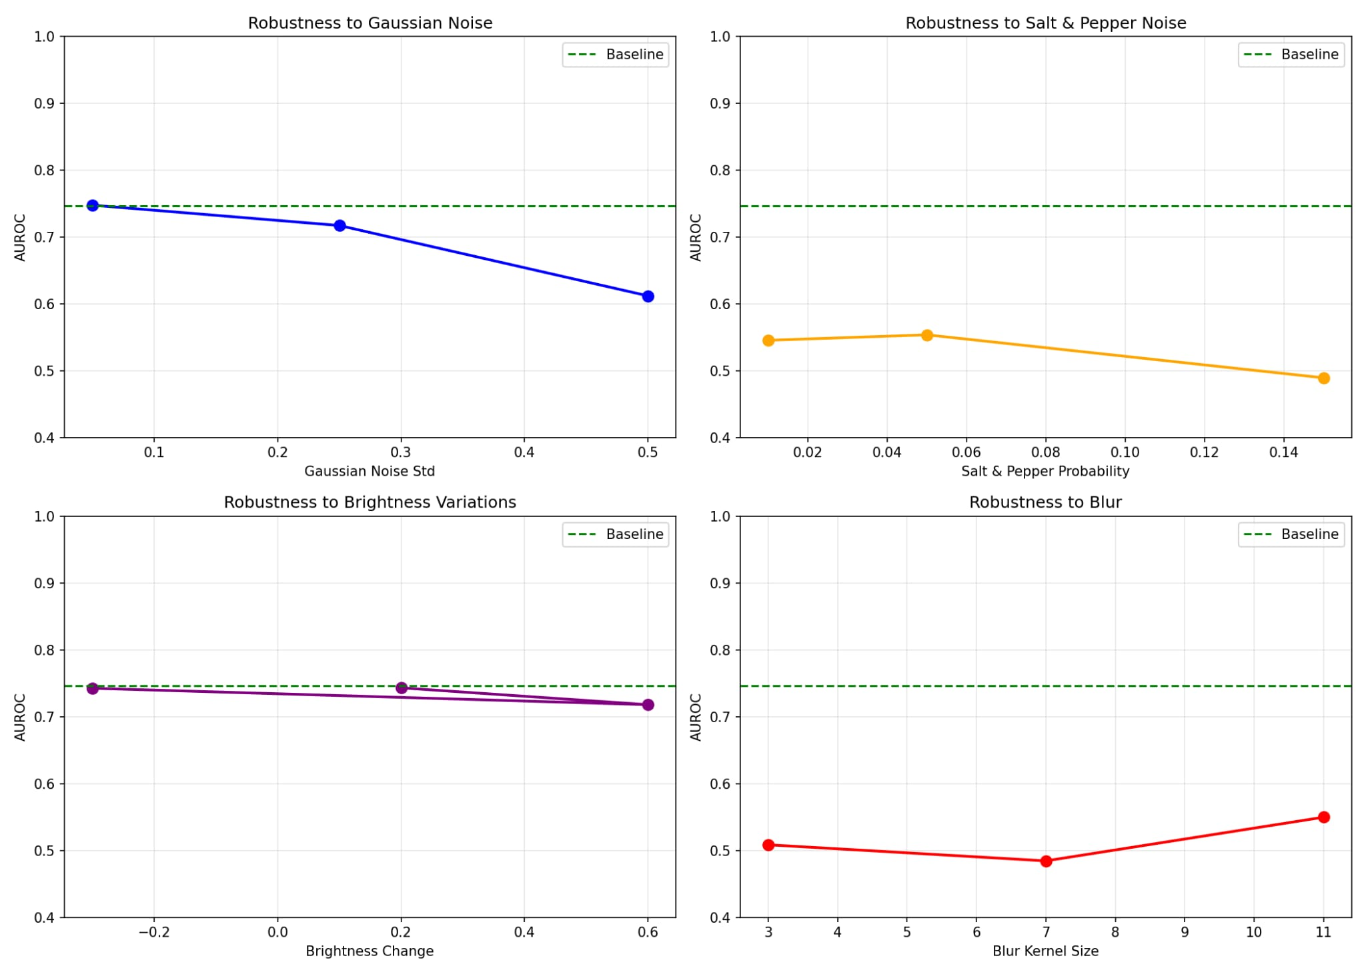
Robustness - Federated

Slide 29
Conclusions
Significant improvement over the U-Net experiments
Federated experiments showed slightly better results than centralised
Got closer to the SOTA than in the previous stage
Didn’t achieve a high fairness level (DI)
Successfully implemented a functional pipeline, setting the basis for a potentially useful tool for real-life applications, with minor modifications/improvements

Slide 30
Thank you!
https://github.com/neagu-marian-claudiu/AITDM_FINAL.git

